Slide 1
Seaside Shotokan Dojo and Defense Arts Center Present: THE DAO OF MARTIAL ARTS: Martial Arts Principles and Healing Date: Saturday, Nov 5, 2016 Time: 1- 5 PM. Place: Seaside Shotokan Dojo 177 Culver Blvd, Playa Del Rey, CA 90293 Sensei Jim Oats (310) 578-1789, Sensei Ty Aponte (951) 204-0341 Topics: Martial Arts and Philosophy: Martial Arts as a Do/Tao. Meditation, Mindfulness & Breathing Perceptual Exercises & Application to Martial Arts Principles vs Rules in the Martial Arts Shuhari: principles of learning in Martial Arts Striking points as healing points Art of Healing

Slide 2
Dean Pickard, Ph.D., Professor of Philosophy, Black Belt 5th Degree USKL (1980), 4th Degree SKL (1978): Sensei Pickard began training in fall of 1965 in Shorin Ryu when he was a freshman in university. He returned to California in 1966 and joined Statewide Karate League in Riverside California under Sensei Richard Nakano. In 1974 he founded the United States Karate League (USKL). He first taught in Riverside SKL, then also started other dojos in California in Hemet, Moorpark College, Claremont Colleges, and Pierce College. He retired from active martial arts teaching and full-time philosophy teaching in 2004, taught part-time regularly from 2006-10, teaches philosophy occassionally now and continues to participate in black belt exams for USKL. http://www.deanpickard.com/

Slide 3
Douglas Krech, OMD, Black Belt 5th Degree, USKL Sensei Krech began training in 1967 with Riverside SKL where he became an instructor in 1970. He was a co-founder of USKL in 1974. Dr. Krech received his OMD (Oriental Medical Doctorate) in 1987. He has practiced various healing arts since then including, functional and alternative medicine, which focuses on treating the underlying cause(s) of a chronic disorder, rather than merely treating the symptoms. He continues his practice today in Pasadena where he uses highly individualized protocols for each patient rather than generic protocols typically used in standard medicine. Medicine is rapidly moving toward such highly individualized treatment based on each an individual’s history, genome, epigenome, metabolome and lifestyle. Dr. Krech, O.M.D. has been at the forefront of such thinking and approaches to treatment/healing for many decades.

Slide 4
The Dao of Martial Arts: Philosophy & Principles

Slide 5
Meditation, Breathing & Daily Practice as a way to wakefulness: Recommended: start each day if possible with: Meditate for at least 10-20 minutes (see meditation below) 5-10 minutes Reading a few powerful inspirational quotes to orient you to the big issues in life Get 20-30 minutes of exercise per day, if you train hard and long, skip a day or two. Sleep well, eat a proper diet, but wait about 3 hours from the time you get up to the time you have your first real meal of the day. Having a light drink & snack just after getting up is fine.

Slide 6
Breathing: yoga: pranayama, Japanese martial arts: Kokyu-ho tanden breathing to focus ki, Chinese martial arts: Qi. Energy, life force. Tan Tiens are the Qi Focus Flow Centers, important focal points for meditative and exercise techniques such as qigong, martial arts such as t'ai chi ch'uan, and in traditional Chinese medicine. THREE MINDS: or the three Tan Tiens refer to the three reservoirs and sources of energy within the body. The upper Tan Tien is located within the upper brain, the middle Tan Tien is located in the heart and the lower Tan Tien in the abdomen The meridians are rivers of energy fed by these reservoirs. The goal of opening the Three Tan Tiens is to continually fill and replenish the energy that is consumed and exchanged by the Three Minds and the rest of the body HARA/GUT/ENTERIC NERVOUS SYSTEM: Relation to Western Medicine and Brain Science: Brain/Gut relation

Slide 7
What are martial arts? Fighting Fighting arts Fighting arts as a Dao

Slide 8
Fighting: this can and does arise naturally as a response to a physical threat or as a result of some mental agitation such as an insult, etc. whether one has much training or not, human beings are equipped with a fight or flight response in the autonomic system or sympathetic nervous system. The onset of a stress response is associated with specific physiological actions in the sympathetic nervous system, primarily caused by release of adrenaline and norepinephrine from the medulla of the adrenal glands. The release is triggered by acetylcholine released from preganglionic sympathetic nerves. These catecholamine hormones facilitate immediate physical reactions by triggering increases in heart rate and breathing, constricting blood vessels and tightening muscles.

Slide 9
2. Fighting Arts: Training is a way to regulate and channel the natural fight or flight response. Training can make our response to physical threat more organized and habitual so our response to a threat is more efficient, more likely to succeed in warding off danger and stopping/redirecting an opponent’s aggression. But fighting arts are NOT necessarily a DAO. You can become highly skilled at martial arts and not be involved in self-overcoming. Knowledge/skill vs wisdom. What is the distinction between karate as a martial art and karate-do?

Slide 10
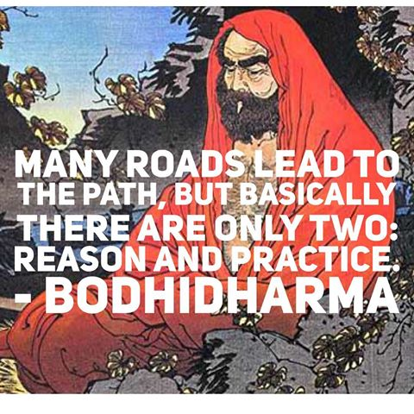

Slide 11
What is a DAO? Usually described as a path to spiritual self-development by a human being. But essential to this is self-overcoming. (pay attention to the final slide)

Slide 12
“Spiritual” refers to the human capacity to be deeply affected, to seek a meaningful connection to something beyond the usual confines of the ego, the capacity for transformation by means of commitment to some DAO of self-overcoming. (pay attention to the final slide)

Slide 13
If karate-do or any martial art is to be engaged in as a Do or Dao, it will not merely be development of skill in technique through training. It must also be guided by some increasing understanding of the wider implications of such a practice and any human practice. So reading the literature of great spiritual teachers and warriors who practiced martial arts as a spiritual Dao is an indispensable part of your training. So let’s identify what makes fighting arts a dao and its relation to philosophy, the pursuit of wisdom.

Slide 14
3. The Relation of Martial Arts to Philosophy: Martial arts as a Dao: A Dao is not a truth. Nietzsche warns “Truths are prisons.” A genuine Dao is a means not a goal, a means that will allow you to move toward your freedom and your freedom moves you toward your unknown possibilities in the process of self-creation. (see Shuhari below) Freedom is only possible through self-overcoming, overcoming the limits through which you engage the world. You must use limits to overcome limits. You are fundamentally a communal being who emerges as a unique identity. Your life is your personal journey of self-creation and as a Dao it is a pursuit of wisdom, seeing, witnessing, epiphany, insight, in a condition of uncertainty and ambiguity. That is the nature of human experience. This pursuit is called philosophy. Seeing through and beyond the limits that make your journey possible finally aims not at skill or knowledge, though these are necessary, but can engender an attitude of wonder and humility in the face of the mystery of an unknowable inexhaustible source of reality.

Slide 15
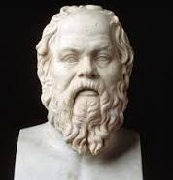
Socrates

Slide 16
“The unexamined life is not worth living. (Socrates) When we take time to reflect on our lives skillfully and carefully, test our unexamined habits of belief, we can liberate ourselves from these habits and live better lives.

Slide 17
“The beginning of wisdom is the recognition of one’s own ignorance.” (Socrates)

Slide 18
Zen proverb: to enter on the path of wisdom one must “empty one’s cup.”

Slide 19
Philosophy is an activity of rigorously questioning and testing our assumptions, habits of beliefs and presuppositions in the pursuit of wisdom. It inevitably leads to epiphanies or insights that may lead to some further construction but then that construction is also “deconstructed” to open the way for further insight. It’s essential feature is undoing what we thought we knew. In doing this, we can engage in our most basic potential: self-overcoming which is essential to growth and freedom. When one has the illusion one has arrived at some final “Truth,” philosophy ceases.

Slide 20
Both Plato and Aristotle tell us that the Eros of wisdom begins in wonder, amazement at the ordinary world we take for granted and, according to Plato, is a kind of divine madness because it pulls us to seek a divine rather than a merely human perspective. It appears to be madness to relentlessly question the apparently self-evident truths of common sense. Radical inquiry operates at the boundary between the known and the unknown. It presupposes that one already has a known world and sense of identity, a sense of being at home in the world that can be overturned. No human can live without a sense of the ordinary, a sense of being connected in some way or other. The possibility of having one’s world overturned, whether by the practice of philosophy or the vicissitudes of life, is a manifestation of our basic condition as vulnerable, interpreting, meaning-making beings. The path to wakefulness is when you actively pursue wisdom. The most profound manifestations of this basic vulnerability that make conscious, meaningful awareness possible are the primordial experiences of wonder, awe, horror, and anguish, all of which are experiences of the opening and/or loss of one’s world or center of meaningfulness.

Slide 21
There have been two complimentary approaches to philosophy in the lineage from Socrates: one has been a theoretical pursuit for its own sake and the other has been a means to living a better human life. For Socrates, philosophy aimed primarily at virtue, care of the self. Philosophy is a process of radical inquiry that is not merely intellectual but inquiry driven by matters of the heart, a desire to understand and improve oneself that can transform who one is. It is a kind of undoing in which we risk ourselves, our meaningfulness in the service of self-understanding and transformation.

Slide 22
Human beings: finite, fallible, vulnerable, communal, interpretive beings, who live in their meanings and who typically are driven by aversion and craving.

Slide 23
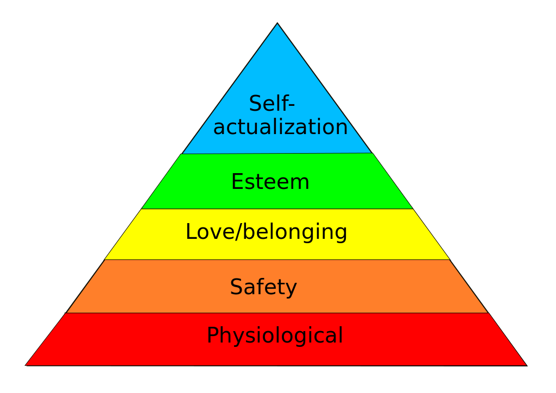

Slide 24
Experience and Meaning

Slide 25
Philosopher fish: “Look at all this water!! (meaning) Ordinary Fish: “What is water?” (meaning)

Slide 26
LANGUAGE

Slide 27
Phenomenology and Philosophical Hermeneutics Two of the most important recent developments in philosophy. Phenomenology is the study of immediate concrete human experience, of the ways things present themselves to us in and through our experience. Philosophical hermeneutics is an attempt to understand understanding itself and the process of interpretation that is basic to all thought. It uses phenomenology of language and communication as its concrete starting point rather than an abstract theoretical approach.

Slide 28
Levels of Interpretation 1. Ordinary sense: interpret a poem, painting, event, speech, book, interpret from one language to another 2. Unconscious Interpretive reflexes that develop with our acquisition of language and upbringing that shape and determine “truth” “reality “value.” These unknown or partly known interpretive reflexes can be revealed through psychotherapy, literature, art, or philosophy. Since the world can be variously interpreted and most people do not carefully test their views, the truths that are obvious to them bring them into conflict with each other. However, some interpretations are more well-informed and well-tested. Neither relativism nor absolutism are sustainable views of truth. 3. The deepest level of interpretation is universal to all human experience. It is what makes the other two levels possible. Experience is fundamentally synthetic, a process of making intelligibility in which things are meaningful. Experience and interpreting in this deepest sense are not two different things. Interpreting does not happen in experience, it is constitutive of experience. Experience is the process of meaning-making in which any particular meaning can arise. This level is only accessible careful descriptive study of phenomena temporarily setting aside our abstractions. It is the attempt to understand understanding itself.

Slide 29
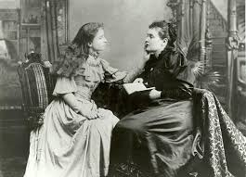

Slide 30
“Before my teacher came to me, I did not know that I am. I lived in a world that was no-world. I cannot hope to describe adequately that unconscious, yet conscious time of nothingness. I did not know that I knew nothing, or that I lived or acted or desired. I had neither will nor intellect. I was carried along to objects and acts by a certain blind natural impetus. .. .My inner life, then, was a blank without past, present, or future without hope or anticipation, without wonder or joy or faith... I was not conscious of any change or process going on in me... When I learned the meaning of "I" and "me" and found that I was something, I began to think. Then consciousness first existed for me... It was the awakening of my soul that first rendered my senses their value, their cognizance of objects, names, qualities, and properties. Thought made me conscious of love, joy, and all the emotions. I was eager to know, then to understand, afterward to reflect on what I knew and understood, and the blind impetus, which had before driven me hither and thither at the dictates of my sensations, vanished forever. (Helen Keller, The World I Live In)

Slide 31
It is the development of self-awareness through language and concept use that opens up meaningfulness. It is the context in which abstract expectations, value judgments, and all aspects of personhood and interpersonal relations arise. Human beings are most fundamentally interpretive beings who live in their meanings.

Slide 32
All understanding is interpretation, and all interpretation takes place in the medium of a language... Understanding is a product of life, not a logical product of propositions. Logical propositions and the arguments in which they are used only have their life in the context of my whole understanding. They do not stand outside it. (Gadamer)

Slide 33
Since reality is always manifested through our finite historical/temporal collective and individual sense of things, by means of our fundamental interpretive condition, the very nature of reality—what it is to be real—is thus itself self-transcending and emergent, always on the way. There is always ambiguity to “the real.” The “correct form for its expression is ultimately undecidable, that is, we cannot remove our responsibility for the judgment involved in answering to its imperative…. We can always “see better,” and this development always involves an intensification of our own involvement, an effort of creativity through which we develop our own reality as much as we discern what was lying in wait. Telling the truth means answering to this demand for further explication through creative expression and self-development.

Slide 34
The arrogance of finitude is an unavoidable condition. Arrogance is overstepping one’s boundaries, over estimating one’s grasp of things. We are finite beings who operate from our prejudices. These are the limits, habits, and assumptions we rarely examine. They enable us to have a point of view that we usually take as “the way the world is.” We all know we are fallible, but we don’t keep it upper most in mind that even when we are “right” it is always within the hermeneutical limits that make our meaningful world possible. Becoming hermeneutically aware of our linguisticality is a powerful confrontation with our prejudices and our finitude. It is a movement away from the arrogance of finitude. To grasp one’s finitude is to engender humility.

Slide 35
The normative dimension of philosophical hermeneutics centers on the recognition of other people as sharing our same basic condition as vulnerable, fallible, interpreting beings to whom things matter. Ethical awareness begins with recognition of our commonality, recognizing the other as oneself. This is the principle of reciprocity of expressed in the many versions of the Golden Rule, the most widely expressed ethical principle in human societies. There is an ethical demand in the recognition of the other as linguistical because to be a linguistical being is inherently a being to whom things matter, a vulnerable being operating within horizons of a meaningful world

Slide 36
It is less events themselves that disturb us, than our interpretation of their significance. Don't demand or expect that events happen as you would wish them do. Accept events as they actually happen. That way, peace is possible. As you think, so you become.....Our busy minds are forever jumping to conclusions, manufacturing and interpreting signs that aren't there. (Epictetus: 1st cent Greek Stoic Philosopher)

Slide 37
What is Meditation?

Slide 38
It is a practice of calming or stilling the mind that allows us to notice the very nature of conscious awareness and be more fully present with it which brings many advantages. This skill of cultivating wakefulness allows us to elevate the pleasures in life without becoming addicted to them and it allows us to distinguish the inevitable and frequent pain/discomforts of life from suffering so we have no aversion to discomfort. The aversion itself creates more discomfort. Suffering is something we add due to what we make things mean. Much of what happens in life is not in our control. But our reactions and what we make it mean is within our control…with practice

Slide 39
Among the reasons why meditation is worthwhile: You can dramatically extend life—not by multiplying the number of your years, but by expanding the fullness of your moments

Slide 40
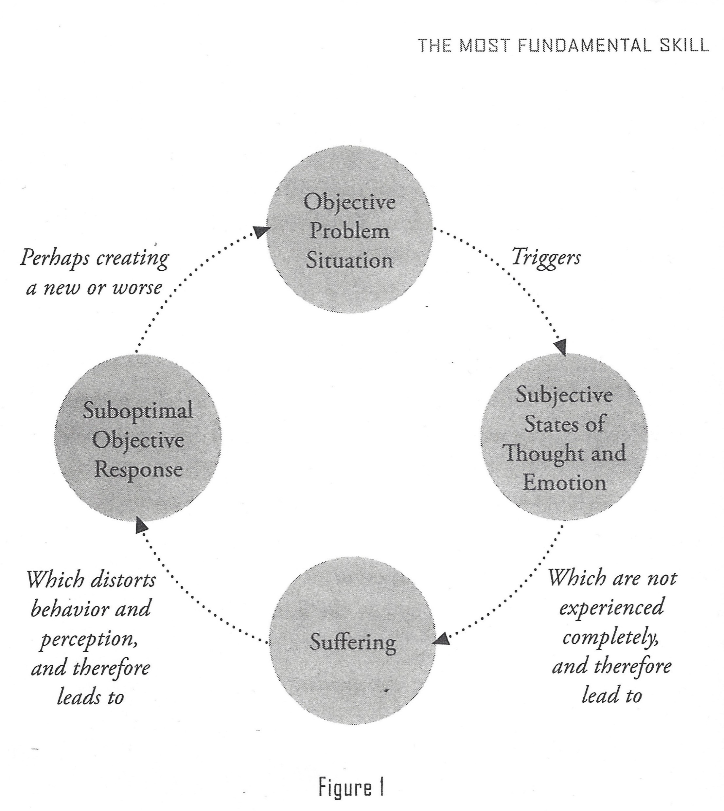

Slide 41
Major insight about distortion and suffering: The salient feature of suffering is that it distorts meaning and behavior. The graph above (from Shinzen: The Science of Enlightenment) illustrates the general pattern that underlies most of human suffering and conflict from the interpersonal to the international level. It is so universal and pervasive that its ubiquity goes unrecognized. An objective situation presents itself (someone says something critical of you, (interpersonal)… Russian planes attack positions in Syria-(international)). An objective situation can affect our subjective thoughts and feelings by what we make it mean. Then we make an objective response, we say or do something. Most people do not maintain a mindful relationship with their subjective thoughts, feelings and habits of interpreting, so most people do not have the ability to experience pain/discomfort (anger, fear, irritation, impatience, indignation, humiliation, sadness, frustration, shame, confusion, etc.,) without suffering and then further contributing to the cycle of distortion in their reactions.

Slide 42
When objective behavioral reactions are nonoptimal, they sow the seeds for new problems that cause distress without resolving/dissolving the old ones that led to the discomfort we are reacting to. So our suffering multiplies and the distortion multiplies and our reactions to things become and/or remain habitual and largely unconscious. These run our lives. Our reactions seem perfectly justified because we are almost completely unaware of what has actually happened and why and do not see how we have multiplied the distortion and the suffering that led, at least in part, to the objective situation. With people who are mindful, that distortion does not get multiplied as it does with almost everyone else (all of whom would deny this! They just think they have it right!) That is because they are not observing what actually happens and are swept away with long standing interpretive reflexes that then just compound the distortion. The emotional subjective responses then get turned into more suffering which gets blamed on other people, other countries, etc. To say “Well, that’s just the way the world is” avoids responsibility for what is in our power to do about this pervasive human condition in how we react to things.

Slide 43
Meditation goes right to the source!! It reveals this distortion loop, this process that leads to instantaneous suffering and frees us from it. We then can simply respond to what happens instead of what we make it mean. Once we separate the pain/discomfort from the suffering then it is possible to observe this loop of distortion and compounded suffering without adding to it. There are real objective problems in the world, much of it caused by this distortion loop at all levels of human interaction, personal, family, community, national, and international. There are massive international problems, for example, most of which is a product of distortion and unexamined habits of judging things. And in personal relationships where uncomfortable feelings arise, if we do not prevent that distortion loop, then the relationship deteriorates into a non-genuine one where the partners are not taking responsibility for those distortions and the further negative action they take on that basis. Relationships that supposedly “work” because overt conflict is not present, but where there is no mindfulness, no genuine practice of the Golden Rule, are empty relationships and if you examine them, life is NOT this fullness mentioned in a previous slide.

Slide 44
So the loop of distortion just multiplies unless someone breaks the loop by first taking responsibility for what they contribute to the objective circumstance and then work with their partner who also takes responsibility. If one partner will not do this, the relationship will likely not work. One must be open to self-examination and self-criticism. If both partners will not do that, it puts resolution further out of reach. If you become aware of and take responsibility for your distortions, it can transform you and may transform the other person and the relationship. Seeing through what we thought we knew and were justified in, frees us gradually to no longer participate in that loop of distortion and suffering. But we are communal beings. We cannot do it alone. We can only do it together and we often need guidance, mutual patience, love, and we must remain open to seeing beyond our limits by establishing new ones, new perspectives. Being open is necessary to self-overcoming and living a more full and wakeful life. It is an ongoing task: self-understanding and self-overcoming

Slide 45
Enlightenment: “a kind of permanent shift in perspective that comes about through direct realization that there is no thing called “self” inside you…there is certainly an activity inside you called personality, an activity of self.” But it is not a thing. Meditation changes your relationship to sensory experience including your thoughts and body sensations. It allows you to experience thought and body sensations in a clear and unblocked way. (The Science of Enlightenment. Shinzen Young, p.2) “Enlightenment is the ability to form a clear see-hear-feel representation of that which precedes each arising of see-hear-feel.” (Shinzen, p157) Two ways to approach this transfinite I-am-ness are 1) meditate on the I-am-ness behind each I-am-ness until you come to an I-am-ness that is not limited to mind-body. This is the method called “self-enquiry.” 2) An alternative approach is to carefully observe the body-mind experience, breaking it into its components, subcomponents, and sub-components until you come to the realization that mind-body experience is literally made of expanding-contracting space. The latter approach is the classical observing practice of Southeast Asia--- Vipassana.

Slide 46
Principles in the Martial Arts Rules versus principles: Rules tell you what to do or not do. Principles do not. Principles are a general guide. For example, the Golden Rule is not a rule but a principle. The Ten Commandments are rules. In Karate, we have rules that guide specific action, such as how to punch properly. These rules are means to the process of learning and development. But ultimately, it is principles we follow, not rules and the principles are governed by a few prime principles as we shall see.

Slide 47
All principles are mental/physical. We are a mind/body. Nonetheless, it is instructive to see principles as dividing into two types:

Slide 48
Physical Principles: Principle of Effectiveness: Does it work? If not, train harder, smarter, more creatively, make adjustments consistent with other principles. Just because something does not work does not mean it cannot, and just because techniques exist does not mean you must use them. A smaller number of highly polished technique with some diversity is far better than a much larger repertoire of technique less polished. Ultimately, all things equal, other factors than technique will prevail, such as spirit, attitude, will.

Slide 49
No hesitation: commit fully

Slide 50
Use of faking. Draw opponent into vulnerable position

Slide 51
Do the unexpected (when in serious danger there is no such thing as cheating. In sport and with your training partner, rules of conduct apply)

Slide 52
Be Relentless, always follow up: do not stop until the job is done. This is where most fighters fail and it is the place where most opponents become most vulnerable.

Slide 53
TIMING: Become one with the target.

Slide 54
Principles of encounter: 1. Hit first, no telegraph (in actual self-defense must be in imminent danger, such as a knife, gun, threatening behavior) 2. Intercept. Allow opponent to commit and strike during the attack with strike or simultaneous block strike 3. Avoid or block and Counter: Allow opponent to expend much or most of attack respond to or create opening with repositioning, such as angling using strike or simultaneous block/strike

Slide 55
Conservation of motion/energy

Slide 56
Efficiency/Simplicity: getting more done with less. Optimally, in a physical environment, an opponent will literally not know what happened. More advanced: no technique is necessary.

Slide 57
Unity of motion: Body does not work against itself

Slide 58
Kime: Move from the center, tanden, tan tien, energy field located in the gut: bringing your energy to a focus in some effective manner. Hara: located just below the navel through the body to the lower back (also refers to one’s spiritual center and fortitude)

Slide 59
From relaxation… speed: Eliminate any patterns of physical/mental tension (do not go limp!)

Slide 60
Accumulation of energy-relaxation-speed-focus = power… but effective? If you cannot be effective, then you must refine your mental/bodily engagement in training.

Slide 61
Principle of Technique: Every technique has its proper application and context. What that is, is never fixed, but fluid. Never approach fighting with technique in mind, rather be fully present. No thought, no judgment. Whatever training and muscle memory you have should now flow. Put all energy into the tanden/hara or tantien and move from that center. But that should also have become habit. Do what comes fluidly and naturally. If you think, you may interrupt this flow. Awareness and thinking are not the same. There is a proper context for each. Efficiency and conservation of energy/movement get interfered with if you are planning you moves while you are carrying them out. If you have planned your moves in advance, then you have given your opponent an advantage. If you have a very undeveloped opponent, then you may be able to do many less efficient things, think too much, etc and still prevail. The more challenging the environment, the more the principles will need to be in play to be effective.

Slide 62
Mental/Moral Principles

Slide 63
1. Principle of Non Violence: No anger, no malice, no retaliation (legally, if you retaliate after real combat has ceased, you can be prosecuted). 2. Mushin- wu wei wu:- Be fully present, fully alert, no abstract thoughts images of past or future. Mushin is the means to spontaneity (mushin no shin, Zen expression, “the mind without mind.” In martial arts, the state of mind when long training has allowed for complete spontaneity in combat. 3. ENERGY: Develop a habit of properly placing energy when confronting an opponent in training or actual combat. Energy to the center: Hara or tanden. This should be a habitual mental/physical state. 4. Principle of Training: push your limits and push your partner’s limits always mindful of protecting your partner by your own high level of skill. If you are not highly skilled, then go according to your level. Your partner is your partner in mutual self-overcoming.

Slide 64
ATTITUDE: habitual but well-considered ways of thinking or feeling typically reflected in a person's behavior. The attitude of the martial artist includes the following: Respectful, courteous, non-violent in language and conduct, helpful, trustworthy, reliable. Note that these qualities are essential to human society. Martial arts as a DAO promote an ethical way of being in the world. The common way of referring the principle that guides this is THE GOLDEN RULE: Treat others as you would be treated CHARACTER: the mental and moral qualities distinctive to an individual that reflect this attitude

Slide 65
If your training has instilled action guided by these principles, and your movement becomes spontaneous, then strategy moves from thinking (separation of you and object/target) to unity, natural flow of consciousness (see 1979 Black Belt Magazine article: The Artless Art, by Dean Pickard)

Slide 66
Principles of Self-Defense

Slide 67
Psychological/Physical: A. voidance: Do not go into potentially dangerous situations if possible B. If you must go into such situations, stay alert and aware of surrounding C. Avoid looking weak, project confidence but not arrogance that could elicit a challenge D. Avoid places where you can get cornered E. Always be aware of an exit strategy F. Depending on the level of threat, do not hesitate to use a weapon, pencil, book, keys, etc.

Slide 68
Legal: Know the law (From The Law of Self Defense, 3rd Ed. by Andrew F. Branca.)

Slide 69
Principle of Innocence you effectively withdraw from the conflict and the other party pursues; your aggression was only of non-deadly force and the other party escalates to deadly force.

Slide 70
Principle of Imminence to the notion that you can defend yourself with force only against a threatened danger that is about to happen RIGHT NOW. You can’t use force to prevent a danger that may arise at some later time—the law expects you to seek an alternative resolution in the mean time, such as calling the police–nor may you use force in response to a danger that has already occurred or passed—doing so would be retaliation, not self defense.

Slide 71
Proportionality—The “Goldilocks” Principle (Just Right). The principle of Proportionality refers to the notion that the degree of force you may use in self-defense must be proportional to the degree of force with which you are threatened. Briefly, a non-deadly threat may only be countered with a non-deadly defense. A threat capable of causing death or grave bodily harm (e.g., a broken bone, blinding, a rape) may be met with deadly force. Usually, the use of deadly force against an unarmed attacker is fatal to a claim of self defense. If you nevertheless wants to argue self defense you will have to convince the court that the unique circumstances warranted your use of deadly force despite the fact that the attacker was unarmed. In many states, the fact that the attack occurred in the defendant’s home often raises a legal presumption of a threat of death or grave bodily harm (e.g., the so-called “make-my-day” laws). Such legal presumptions are rebuttable by a preponderance of the evidence.

Slide 72
Avoidance—A Duty to Retreat as Long as Safely Possible: you should not use force in self-defense if you can avoid the need to do so by making use of a safe avenue of retreat. Today, only 17 states have a generalized “duty to retreat”–the other 33 are effectively “stand-your-ground” states, even if they don’t have an explicit “stand your ground” statute. Even the “duty-to-retreat” states ALWAYS have an exception for one’s home, temporary dwellings, (e.g., hotel rooms, campers, tents), your place of business, and even your occupied vehicle. Also, it’s important to emphasize that you are NEVER required to retreat if attempting to do so would increase your danger. *you were the aggressor–or can be made to appear as if you were the aggressor–then retreat may be your best means of “regaining” your innocence and your right to lawfully use defensive force

Slide 73
Principle of Reasonableness An umbrella principle that applies to each of the previous four. The issue here is whether your perceptions and conduct in self-defense were those of a reasonable and prudent person under the same or similar circumstances, and possessing the same specialized skills and knowledge (if any). If your actions were not reasonable by this standard, any claim to self-defense fails. So, if you believed the other person was an aggressor, but a reasonable person would not have believed this, you did not act in lawful self-defense. Similarly if you believed that the threat was imminent but a reasonable person would not have, or that the force you used was proportional to the threat but a reasonable person would not have, or that you could not have avoided the threat but a reasonable person would have . . . in each case the claim to self defense fails. It is within the contours of the principle of Reasonableness that the attacker’s prior acts and/or reputation might be made relevant at trial, even if they were unknown to you at the time. The reasonableness of your perception that the attacker’s behavior was threatening would be strengthened if your attacker had a reputation in the community for behaving in threatening manner. Similarly, the reasonableness of your perception that the attacker was acting in an irrational and frightening manner would be buttressed if your attacker habitually used intoxicants, and was in fact intoxicated at the time of the attack.

Slide 74
SHUHARI: principle of learning in Martial Arts and in Life An old principle of learning with a new name: shuhari: introduced by Aikido master Endō Seishirō in the 1970’s.

Slide 75
Shuhari roughly translates to shu: First learn, follow, obey, protect, traditional wisdom, learn fundamentals, techniques, proverbs ha: detach, break, digress, create: breaking with tradition, detachment from the illusions of self ri: transcend : No techniques, truths, or proverbs, all moves are natural, becoming one with spirit alone without clinging to forms; transcending the physical

Slide 76
Aikido master Endo Seishiro "It is known that, when we learn or train in something, we pass through the stages of shu, ha, and ri. These stages are explained as follows. In shu, we repeat the forms and discipline ourselves so that our bodies absorb the forms that our forebears created. We remain faithful to these forms with no deviation. Next, in the stage of ha, once we have disciplined ourselves to acquire the forms and movements, we make innovations. In this process the forms may be broken and discarded. Finally, in ri, we completely depart from the forms, open the door to creative technique, and arrive in a place where we act in accordance with what our heart/mind desires, unhindered while not overstepping laws."

Slide 77
Shuhari can be considered as concentric circles, with Shu within Ha, and both Shu and Ha within Ri. The fundamental techniques and knowledge do not change. However, this still reflects a rather traditional way of looking at things. We can see that the probable intent was THE PRINCIPLES do not change, though the knowledge and technique may as they are passed on to the next generation as a TAO. What is passed on is not set, but also not discarded. What is passed on becomes the means for the next generation to pursue freedom and spontaneity

Slide 78
Chinese martial arts, popularly known as Wushu, have a similar three stage concept to Mastery: Di (earth) Basics. To experience movements at the fundamental levels. Ren (human) Ready to learn. (Some Chinese martial grandmasters equates the entry to this level as the Japanese belt system level of black belt 1st Dan Tia (sky/heaven) No conscious thought, flows/moves like the elements. This stage takes years of training and coaching from other Grandmasters.

Slide 79
Relation of SHUHARI, the basic condition of growth and transformation in human experience.

Slide 80
A genuine Dao which mean a path or way is not a goal, but a means that will allow you to move toward your freedom and your freedom moves you toward your unknown possibilities in the process of self-creation. Freedom is only possible through self-overcoming, overcoming the limits through which you engage the world. You must use limits to overcome limits.

Slide 81
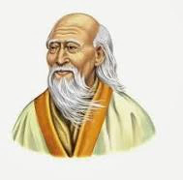
Laozi
Laozi

Slide 82
Laozi (600 BCE) “Knowing others is wisdom, knowing yourself is Enlightenment.” “Do you have the patience to wait until your mud settles and the water is clear?” “Can you remain unmoving till the right action arises by itself?” “If you realize that all things change, there is nothing you will try to hold on to. If you are not afraid of dying, there is nothing you cannot achieve.”

Slide 83
We shall not cease from exploration And the end of all our exploring Will be to arrive where we started And know the place for the first time. From: The Four Quartets, by TS Eliot

Slide 84
Samsara is Nirvana: Luminous mind is like the sun, the defilements are like the clouds blocking it. The light may not shine through but the sun is there all along.

Slide 85
The Relation of Martial Arts to Philosophy: Martial arts as a Tao: A Dao is not a truth. A great philosopher tells us “Truths are prisons.” A genuine Dao which mean a path or way is not a goal, but a means that will allow you to move toward your freedom and your freedom moves you toward your unknown possibilities in the process of self-creation. Freedom is only possible through self-overcoming, overcoming the limits through which you engage the world. You must use limits to overcome limits. You are fundamentally a communal being who emerges as a unique identity. Your life is your personal journey of self-creation and as a Dao it is a pursuit of wisdom, seeing witnessing, epiphany, insight, in a condition of uncertainty and ambiguity. That is the nature of human experience. This pursuit is called philosophy. Seeing through and beyond the limits that make your journey possible finally aims not at skill or knowledge, though these are necessary, but can engender an attitude of wonder and humility in the face of the mystery of an unknowable inexhaustible source of reality.

